Slide 1
COMPLETE
BUSINESS
STATISTICS
by
AMIR D. ACZEL
&
JAYAVEL SOUNDERPANDIAN
7th edition.
Prepared by Lloyd Jaisingh, Morehead State University
Chapter 11
Multiple Regression
McGraw-Hill/Irwin
Copyright © 2009 by The McGraw-Hill Companies, Inc. All rights reserved.

Slide 2
_{11-<number>}
11
Multiple Regression (1)
Using Statistics
The k-Variable Multiple Regression Model
The F Test of a Multiple Regression Model
How Good is the Regression
Tests of the Significance of Individual Regression Parameters
Testing the Validity of the Regression Model
Using the Multiple Regression Model for Prediction

Slide 3
_{11-<number>}
11
Multiple Regression (2)
Qualitative Independent Variables
Polynomial Regression
Nonlinear Models and Transformations
Multicollinearity
Residual Autocorrelation and the Durbin-Watson Test
Partial F Tests and Variable Selection Methods
Multiple Regression Using the Solver

Slide 4
_{11-<number>}
11
LEARNING OBJECTIVES (1)
After studying this chapter you should be able to:
Determine whether multiple regression would be applicable to a given instance
Formulate a multiple regression model
Carry out a multiple regression using a spreadsheet template
Test the validity of a multiple regression by analyzing residuals
Carryout hypothesis tests about the regression coefficients
Compute a prediction interval for the dependent variable

Slide 5
_{11-<number>}
11
LEARNING OBJECTIVES (2)
After studying this chapter you should be able to:
Use indicator variables in a multiple regression
Carryout a polynomial regression
Conduct a Durbin-Watson test for autocorrelation in residuals
Conduct a partial F-test
Determine which independent variables are to be included in a multiple regression model
Solve multiple regression problems using the Solver macro

Slide 6
11-1 Using Statistics
_{11-<number>}
Lines
y
Planes
y
B
B
A
Slope: β₁
C
A
x₁
Intercept: β₀
x₂
x
Any two points (A and B), or an intercept and slope (β₀ and β₁), define a line on a two-dimensional surface.
Any three points (A, B, and C), or an intercept and coefficients of x₁ and x₂ (β₀ , β₁ , and β₂), define a plane in a three-dimensional surface.

Slide 7

11-2 The k-Variable Multiple Regression Model
_{11-<number>}
The population regression model of a dependent variable, Y, on a set of k independent variables, X₁, X₂,. . . , X_{k} is given by:
Y= β₀ + β₁X₁ + β₂X₂ + . . . + β_{k}X_{k} +ε
where β₀ is the Y-intercept of the regression surface and each β_{i} , i = 1,2,...,k is the slope of the regression surface - sometimes called the response surface - with respect to X_{i}.
x₂
y
β₂
β₁
β₀
x₁
Model assumptions:
1. ε~N(0,σ²), independent of other errors.
2. The variables X_{i} are uncorrelated with the error term.

Slide 8
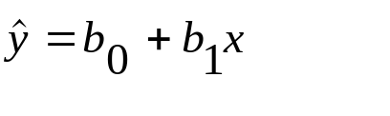

Simple and Multiple Least-Squares Regression
_{11-<number>}
Y
y
x₁
x₂
X
In a simple regression model, the least-squares estimators minimize the sum of squared errors from the estimated regression line.
In a multiple regression model, the least-squares estimators minimize the sum of squared errors from the estimated regression plane.

Slide 9
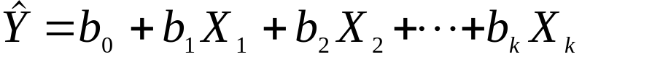

The Estimated Regression Relationship
_{11-<number>}
The estimated regression relationship:
where is the predicted value of Y, the value lying on the estimated regression surface. The terms b_{i}, for i = 0, 1, ....,k are the least-squares estimates of the population regression parameters β_{i}.
The actual, observed value of Y is the predicted value plus an error:
y_{j} = b₀+ b₁ x_{1j}+ b₂ x_{2j}+. . . + b_{k} x_{kj}+e, j = 1, …, n.

Slide 10
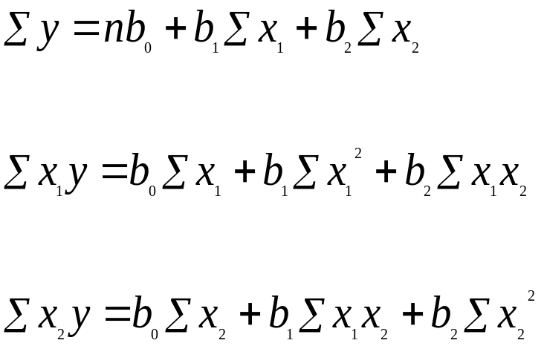
Least-Squares Estimation:
The 2-Variable Normal Equations
_{11-<number>}
Minimizing the sum of squared errors with respect to the estimated coefficients b₀, b₁, and b₂ yields the following normal equations which can be solved for b₀, b₁, and b₂.

Slide 11
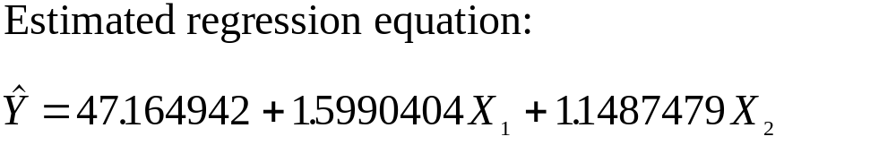
Example 11-1
_{11-<number>}
Y X₁ X₂ X₁X₂ X₁² X₂² X₁Y X₂Y
72 12 5 60 144 25 864 360
76 11 8 88 121 64 836 608
78 15 6 90 225 36 1170 468
70 10 5 50 100 25 700 350
68 11 3 33 121 9 748 204
80 16 9 144 256 81 1280 720
82 14 12 168 196 144 1148 984
65 8 4 32 64 16 520 260
62 8 3 24 64 9 496 186
90 18 10 180 324 100 1620 900
--- --- --- --- ---- --- ---- ----
743 123 65 869 1615 509 9382 5040
Normal Equations:
743 = 10b₀+123b₁+65b₂
9382 = 123b₀+1615b₁+869b₂
5040 = 65b₀+869b₁+509b₂
b₀ = 47.164942
b₁ = 1.5990404
b₂ = 1.1487479

Slide 12
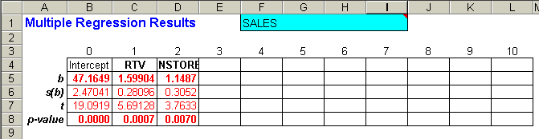
Example 11-1: Using the Template
_{11-<number>}
Regression results for Alka-Seltzer sales
Coefficients

Slide 13
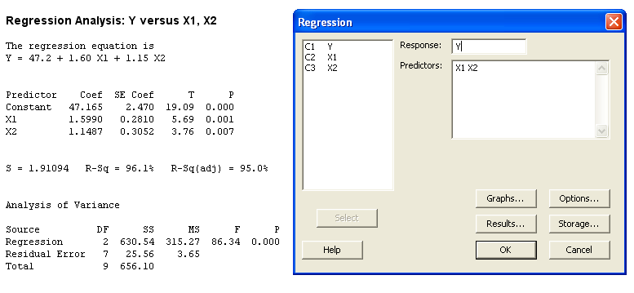
Example 11-1: Using Minitab
_{11-<number>}
The Regression Equation; coefficients are truncated to two decimal places.

Slide 14
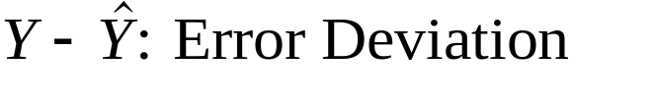
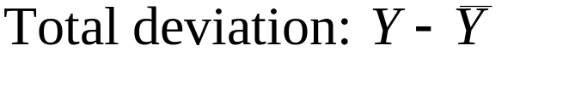
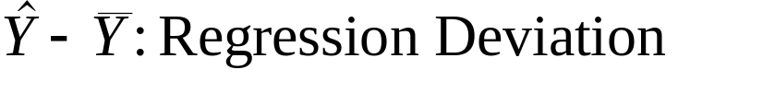
Decomposition of the Total Deviation in a Multiple Regression Model
_{11-<number>}
y
{
}
}
y
x₁
x₂
Total Deviation = Regression Deviation + Error Deviation
SST = SSR + SSE

Slide 15
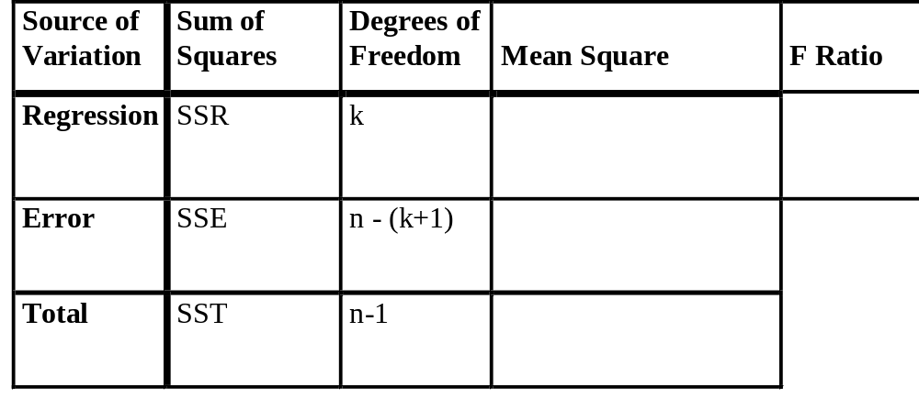
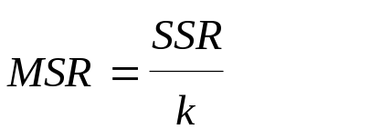
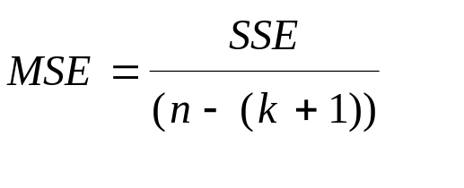
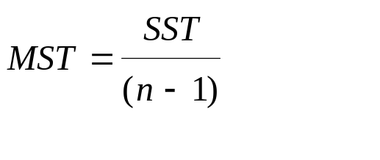
11-3 The F Test of a Multiple Regression Model
_{11-<number>}
A statistical test for the existence of a linear relationship between Y and any or all of the independent variables X₁, X₂, ..., X_{k}:
H₀: β₁ = β₂ = ...= β_{k}= 0
H₁: Not all the β_{i} (i=1,2,...,k) are equal to 0

Slide 16
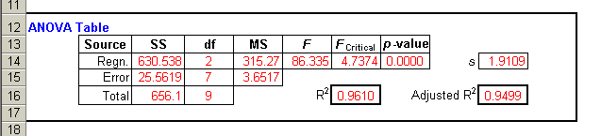
Using the Template: Analysis of Variance Table (Example 11-1)
_{11-<number>}
F
D
i
s
t
r
i
b
u
t
i
o
n
w
i
t
h
2
a
n
d
7
D
e
g
r
e
e
s
o
f
F
r
e
e
d
o
m
The test statistic, F = 86.34, is greater than the critical point of F_{(2, 7)} for any common level of significance
(p-value ≈0), so the null hypothesis is rejected, and we might conclude that the dependent variable is related to one or more of the independent variables.
f(F)
Test statistic = 86.34
α=0.01
F
0
F_{0.01}=9.55

Slide 17
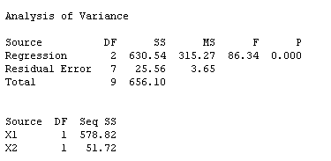
Using Minitab: Analysis of Variance Table (Example 11-1)
_{11-<number>}
F
D
i
s
t
r
i
b
u
t
i
o
n
w
i
t
h
2
a
n
d
7
D
e
g
r
e
e
s
o
f
F
r
e
e
d
o
m
The test statistic, F = 86.34, is greater than the critical point of F_{(2, 7)} for any common level of significance
(p-value ≈0), so the null hypothesis is rejected, and we might conclude that the dependent variable is related to one or more of the independent variables.
f(F)
Test statistic = 86.34
α=0.01
F
0
F_{0.01}=9.55

Slide 18
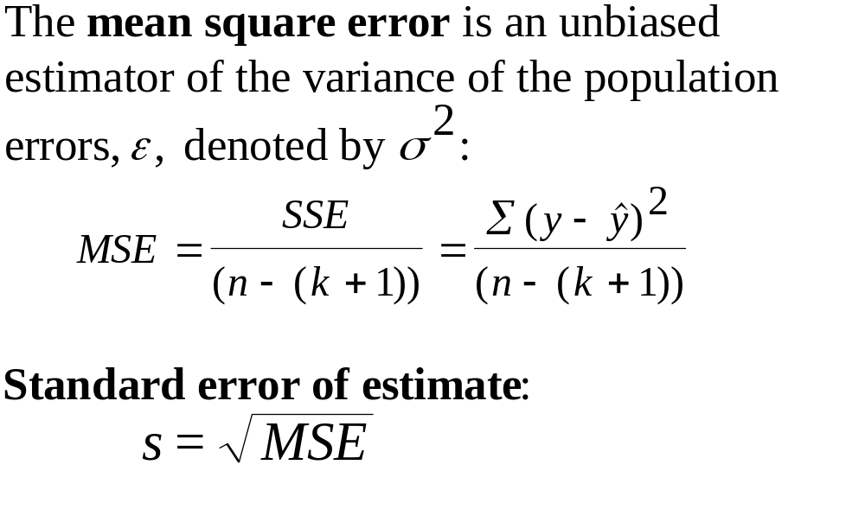

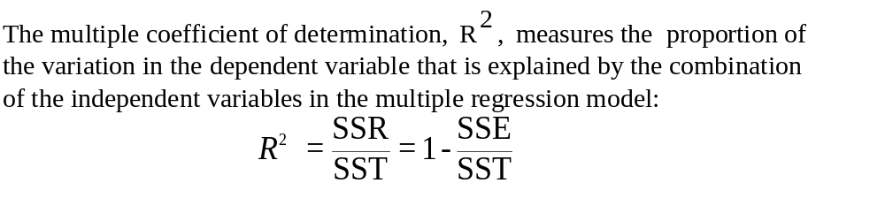
11-4 How Good is the Regression
_{11-<number>}
y
x₁
x₂

Slide 19
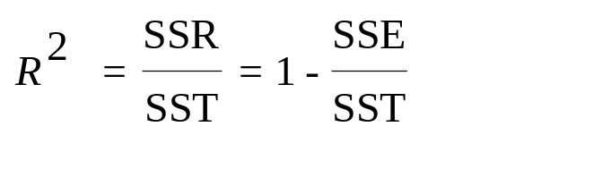
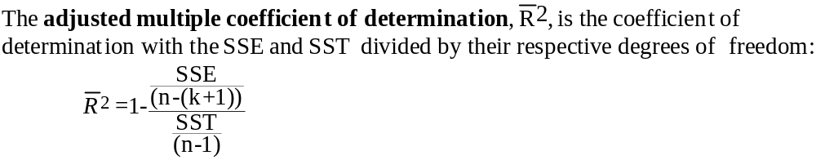
Decomposition of the Sum of Squares and the Adjusted Coefficient of Determination
_{11-<number>}
SST
SSR
SSE
Example 11-1: s = 1.911 R-sq = 96.1% R-sq(adj) = 95.0%

Slide 20
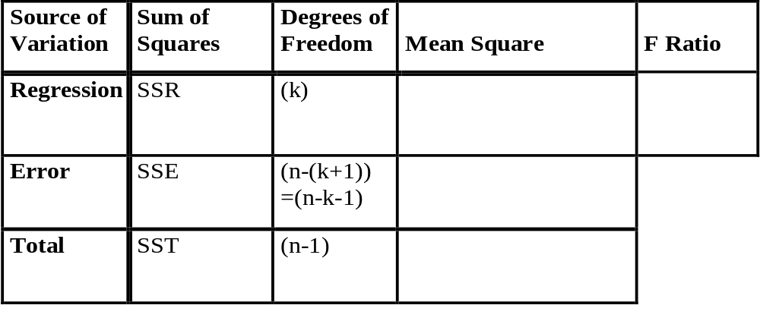
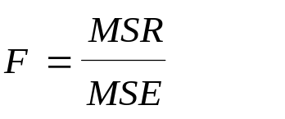
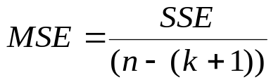
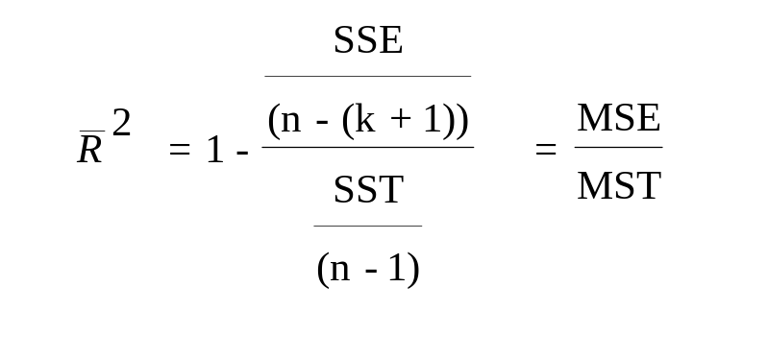
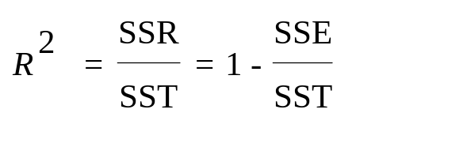
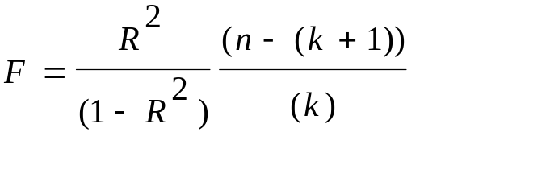
Measures of Performance in Multiple Regression and the ANOVA Table
_{11-<number>}

Slide 21
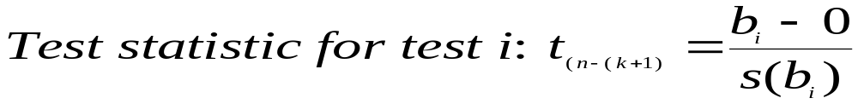
11-5 Tests of the Significance of Individual Regression Parameters
_{11-<number>}
Hypothesis tests about individual regression slope parameters:
(1) H₀: β₁= 0
H₁: β₁ ≠ 0
(2) H₀: β₂ = 0
H₁: β₂ ≠ 0
.
.
.
(k) H₀: β_{k} = 0
H₁: β_{k} ≠ 0

Slide 22
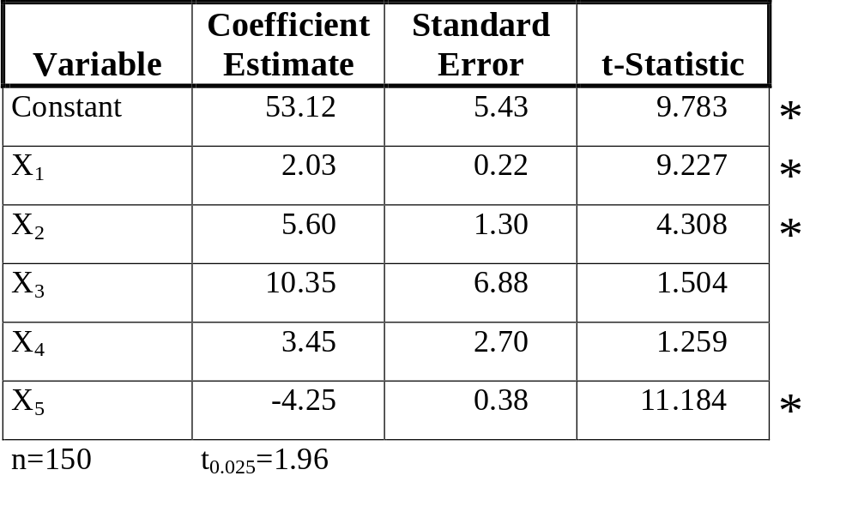
Regression Results for Individual Parameters (Interpret the Table)
_{11-<number>}

Slide 23
Example 11-1: Using the Template
_{11-<number>}
Regression results for Alka-Seltzer sales

Slide 24
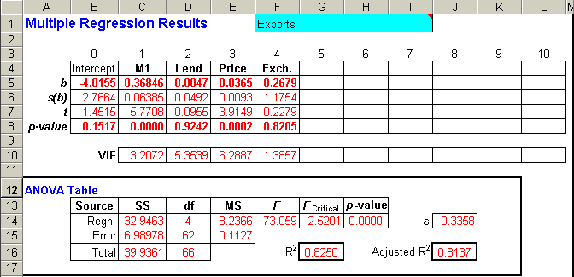
Using the Template: Example 11-2
_{11-<number>}
Regression results for Exports to Singapore
Coefficients

Slide 25
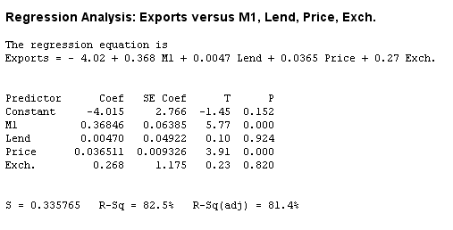
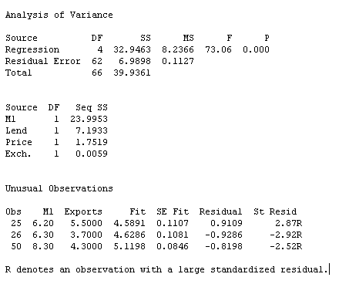
Using Minitab: Example 11-2
_{11-<number>}
Regression results for Exports to Singapore
Regression Equation

Slide 26
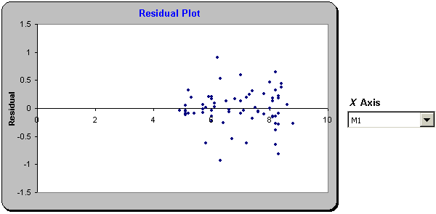
11-6 Testing the Validity of the Regression Model: Residual Plots
_{11-<number>}
Residuals vs M1 (Example 11-2)
It appears that the residuals are randomly distributed with no pattern and with equal variance as M1 increases

Slide 27
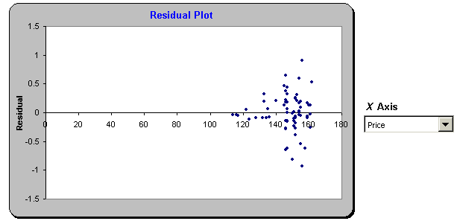
11-6 Testing the Validity of the Regression Model: Residual Plots
_{11-<number>}
Residuals vs Price (Example 11-2)
It appears that the residuals are increasing as the Price increases. The variance of the residuals is not constant.

Slide 28
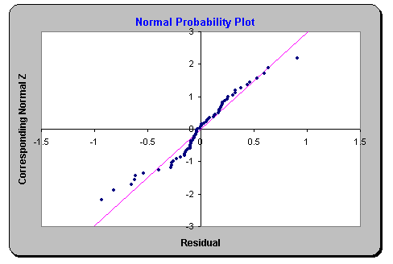
Normal Probability Plot for the Residuals: Example 11-2
_{11-<number>}
Linear trend indicates residuals are normally distributed

Slide 29
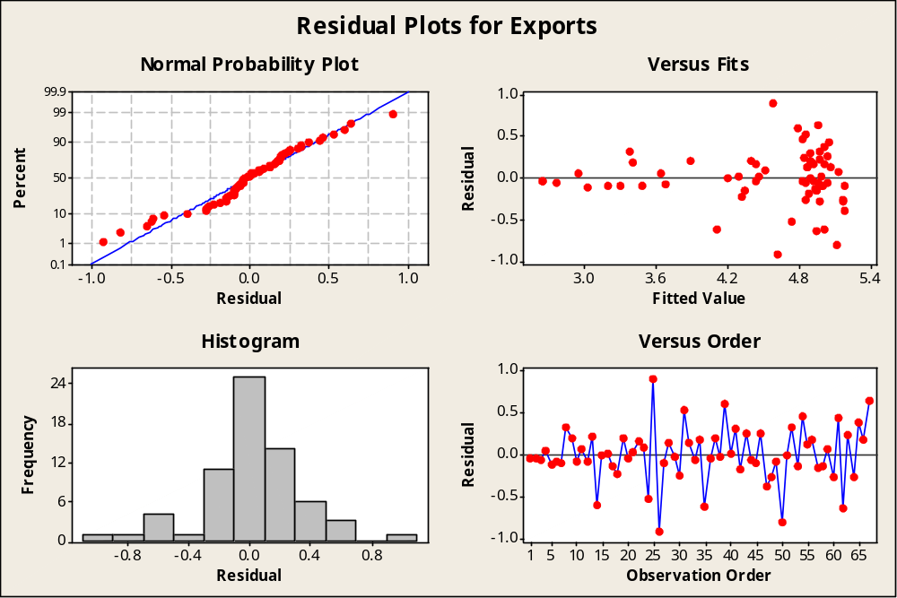
Residual Plots from Minitab to help Assess Assumptions: Example 11-2
_{11-<number>}

Slide 30
Investigating the Validity of the Regression: Outliers and Influential Observations
_{11-<number>}
Regression line without outlier
Point with a large value of x_{i}
*
y
.
y
.
.
.
.
.
.
Regression line with outlier
Regression line when all data are included
.
.
.
.
.
.
.
.
.
.
.
.
.
.
.
.
.
.
.
.
.
.
.
.
No relationship in this cluster
* Outlier
x
x
Outliers
Influential Observations

Slide 31
Possible Relation in the Region between the Available Cluster of Data and the Far Point
_{11-<number>}
y
Point with a large value of x_{i}
*
x
Some of the possible data between the
original cluster and the far point
x
x
x
.
x
x
.
x
x
x
x
.
.
.
x
x
.
.
.
x
x
x
x
.
.
.
.
x
.
.
.
x
x
x
x
x
More appropriate curvilinear relationship (seen when the in between data are known).
x

Slide 32
Outliers and Influential Observations: Example 11-2
_{11-<number>}
Unusual Observations
Obs. M1 EXPORTS Fit Stdev.Fit Residual St.Resid
1 5.10 2.6000 2.6420 0.1288 -0.0420 -0.14 X
2 4.90 2.6000 2.6438 0.1234 -0.0438 -0.14 X
25 6.20 5.5000 4.5949 0.0676 0.9051 2.80R
26 6.30 3.7000 4.6311 0.0651 -0.9311 -2.87R
50 8.30 4.3000 5.1317 0.0648 -0.8317 -2.57R
67 8.20 5.6000 4.9474 0.0668 0.6526 2.02R
R denotes an obs. with a large st. resid.
X denotes an obs. whose X value gives it large influence.

Slide 33
11-7 Using the Multiple Regression Model for Prediction
_{11-<number>}
Sales
Estimated Regression Plane for Example 11-1
89.76
Advertising
18.00
63.42
8.00
Promotions
12
3

Slide 34
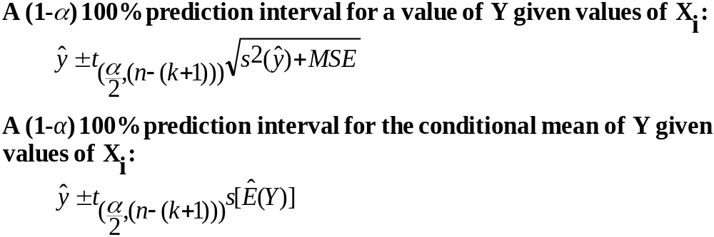
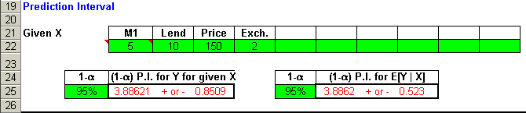
Prediction in Multiple Regression
_{11-<number>}

Slide 35
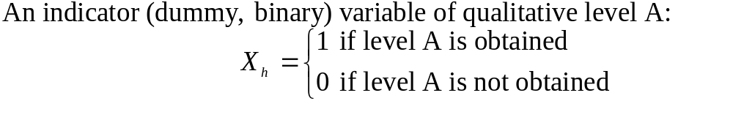
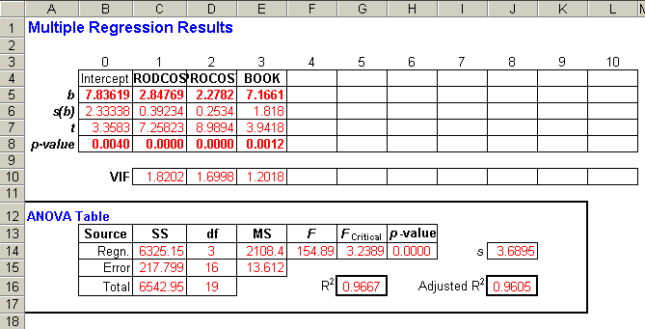
11-8 Qualitative (or Categorical) Independent Variables (in Regression)
_{11-<number>}
MOVIE EARN COST PROM BOOK
1 28 4.2 1.0 0
2 35 6.0 3.0 1
3 50 5.5 6.0 1
4 20 3.3 1.0 0
5 75 12.5 11.0 1
6 60 9.6 8.0 1
7 15 2.5 0.5 0
8 45 10.8 5.0 0
9 50 8.4 3.0 1
10 34 6.6 2.0 0
11 48 10.7 1.0 1
12 82 11.0 15.0 1
13 24 3.5 4.0 0
14 50 6.9 10.0 0
15 58 7.8 9.0 1
16 63 10.1 10.0 0
17 30 5.0 1.0 1
18 37 7.5 5.0 0
19 45 6.4 8.0 1
20 72 10.0 12.0 1
EXAMPLE 11-3

Slide 36


Picturing Qualitative Variables in Regression
_{11-<number>}
Y
y
Line for X₂=1
b₃
b₀+b₂
Line for X₂=0
x₁
b₀
x₂
X₁
A regression with one quantitative variable (X₁) and one qualitative variable (X₂):
A multiple regression with two quantitative variables (X₁ and X₂) and one qualitative variable (X₃):

Slide 37
Picturing Qualitative Variables in Regression: Three Categories and Two Dummy Variables
_{11-<number>}
Y
A qualitative variable with r levels or categories is represented with (r-1) 0/1 (dummy) variables.
Line for X = 0 and X₃ = 1
Line for X₂ = 1 and X₃ = 0
b₀+b₃
Line for X₂ = 0 and X₃ = 0
b₀+b₂
b₀
X₁
Category X₂ X₃
Adventure 0 0
Drama 0 1
Romance 1 0
A regression with one quantitative variable (X₁) and two qualitative variables (X₂ and X₂):

Slide 38
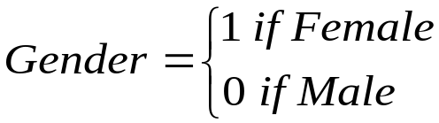
Using Qualitative Variables in Regression: Example 11-4
_{11-<number>}
Salary = 8547 + 949 Education + 1258 Experience - 3256 Gender
(SE) (32.6) (45.1) (78.5) (212.4)
(t) (262.2) (21.0) (16.0) (-15.3)
On average, female salaries are $3256 below male salaries

Slide 39

Interactions between Quantitative and Qualitative Variables: Shifting Slopes
_{11-<number>}
Line for X₂=0
Y
Slope = b₁
Line for X₂=1
b₀
Slope = b₁+b₃
b₀+b₂
X₁
A regression with interaction between a quantitative variable (X₁) and a qualitative variable (X₂ ):

Slide 40

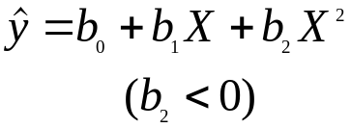

11-9 Polynomial Regression
_{11-<number>}
One-variable polynomial regression model:
Y= β₀+β₁ X + β₂X² + β₃X³ +. . . + β_{m}X^{m} +ε
where m is the degree of the polynomial - the highest power of X appearing in the equation. The degree of the polynomial is the order of the model.
Y
Y
X₁
X₁

Slide 41
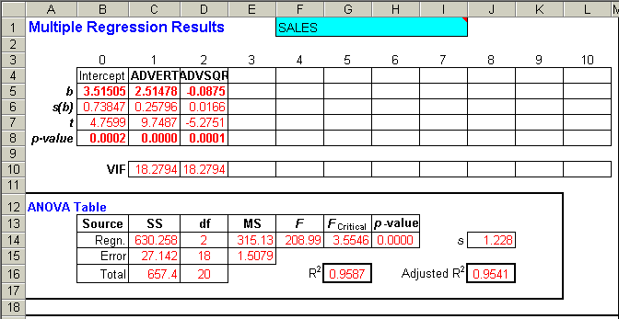
Polynomial Regression: Example 11-5 – Using the Template
_{11-<number>}

Slide 42
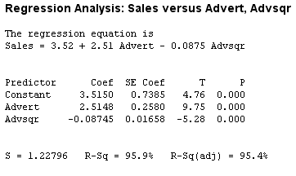
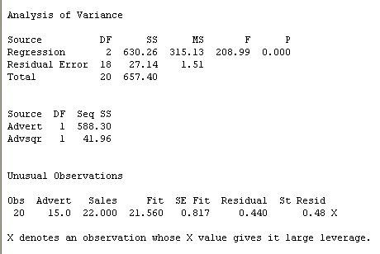
Polynomial Regression: Example 11-5 – Using Minitab
_{11-<number>}

Slide 43
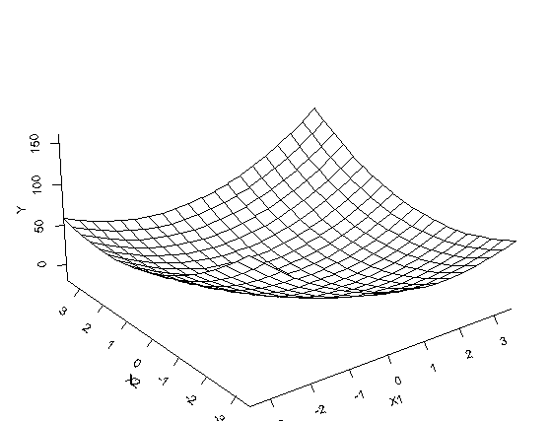
Polynomial Regression: Other Variables and Cross-Product Terms
_{11-<number>}
Variable Estimate Standard Error T-statistic
X₁ 2.34 0.92 2.54
X₂ 3.11 1.05 2.96
X₁² 4.22 1.00 4.22
X₂² 3.57 2.12 1.68
X₁X² 2.77 2.30 1.20

Slide 44
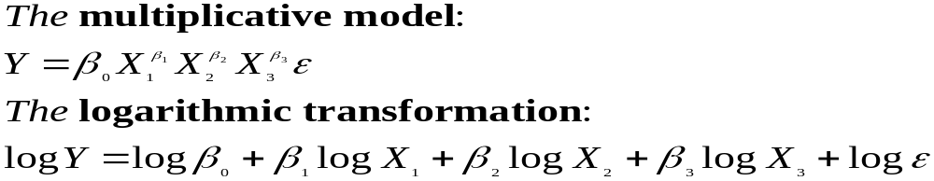
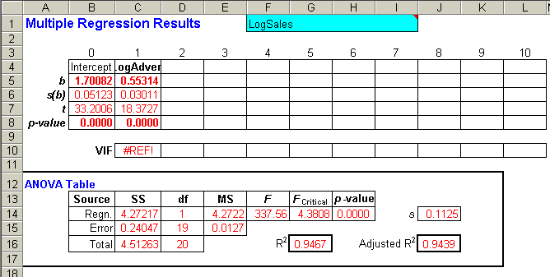
11-10 Nonlinear Models and Transformations
_{11-<number>}

Slide 45
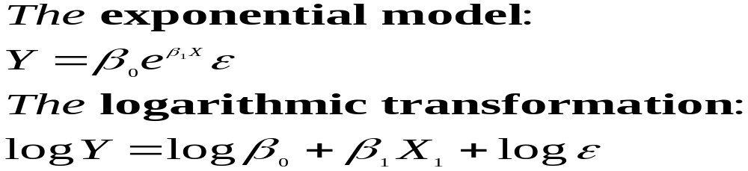
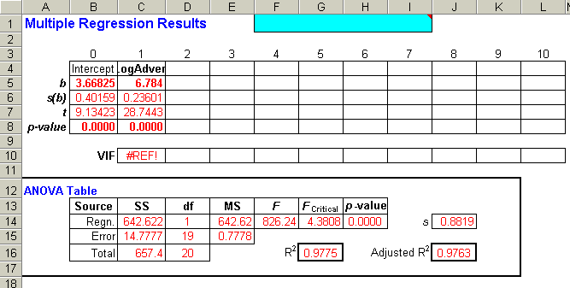
Transformations: Exponential Model
_{11-<number>}

Slide 46
Plots of Transformed Variables
_{11-<number>}
S
i
m
p
l
e
R
e
g
r
e
s
s
i
o
n
o
f
S
a
l
e
s
o
n
A
d
v
e
r
t
i
s
i
n
g
R
e
g
r
e
s
s
i
o
n
o
f
S
a
l
e
s
o
n
L
o
g
(
A
d
v
e
r
t
i
s
i
n
g
)
3
0
2
5
S
2
0
S
1
5
E
E
L
L
A
A
S
Y
=
6
.
5
9
2
7
1
+
1
S
.
1
9
1
7
6
X
Y
=
3
.
6
6
8
2
5
+
6
.
7
8
4
X
1
0
R
-
S
q
u
a
r
e
d
=
0
.
8
9
5
R
-
S
q
u
a
r
e
d
=
0
.
9
7
8
5
0
5
A
D
V
E
R
T
1
0
1
5
0
1
L
O
G
A
D
V
2
3
R
e
g
r
e
s
s
i
o
n
o
f
L
o
g
(
S
a
l
e
s
)
o
n
L
o
g
(
A
d
v
e
r
t
i
s
i
n
g
)
R
e
s
i
d
u
a
l
P
l
o
t
s
:
S
a
l
e
s
v
s
L
o
g
(
A
d
v
e
r
t
i
s
i
n
g
)
1
.
5
3
.
5
0
.
S
5
E
D
L
I
A
S
S
2
E
G
.
5
R
-
0
.
O
Y
=
1
.
7
0
0
8
2
+
0
.
5
5
3
1
3
6
X
5
L
R
-
S
q
u
a
r
e
d
=
0
.
9
4
7
-
1
.
5
1
.
5
2
1
2
2
0
1
2
3
2
L
O
G
A
D
V
Y-HAT

Slide 47


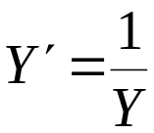
Variance Stabilizing Transformations
_{11-<number>}
Square root transformation:
  Useful when the variance of the regression errors is approximately proportional to the conditional mean of Y
Logarithmic transformation:
  Useful when the variance of regression errors is approximately proportional to the square of the conditional mean of Y
Reciprocal transformation:
  Useful when the variance of the regression errors is approximately proportional to the fourth power of the conditional mean of Y

Slide 48
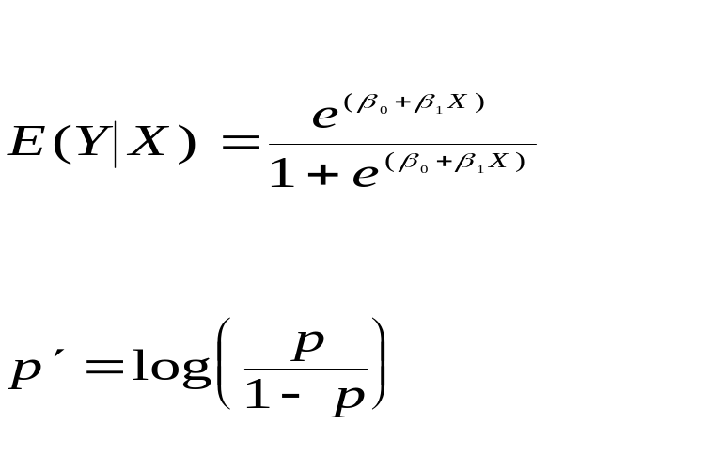
Regression with Dependent Indicator Variables
_{11-<number>}
The logistic function:
Transformation to linearize the logistic function:
y
Logistic Function
1
0
x

Slide 49
11-11: Multicollinearity
_{11-<number>}
x₂
x₁
x₂
x₁
Orthogonal X variables provide information from independent sources. No multicollinearity.
Perfectly collinear X variables provide identical information content. No regression.
x₂
x₂
x₁
x₁
Some degree of collinearity. Problems with regression depend on the degree of collinearity.
A high degree of negative collinearity also causes problems with regression.

Slide 50
Effects of Multicollinearity
_{11-<number>}
Variances of regression coefficients are inflated.
Magnitudes of regression coefficients may be different from what are expected.
Signs of regression coefficients may not be as expected.
Adding or removing variables produces large changes in coefficients.
Removing a data point may cause large changes in coefficient estimates or signs.
In some cases, the F ratio may be significant while the t ratios are not.

Slide 51

Detecting the Existence of Multicollinearity: Correlation Matrix of Independent Variables and Variance Inflation Factors
_{11-<number>}

Slide 52

Variance Inflation Factor
_{11-<number>}
Relationship between VIF and R_{h}²
VIF
1
0
0
5
0
0
R_{h}²
1
0
.
.
0
0
.
5
0

Slide 53

Variance Inflation Factor (VIF)
_{11-<number>}
Observation: The VIF (Variance Inflation Factor) values for both variables Lend and Price are both greater than 5. This would indicate that some degree of multicollinearity exists with respect to these two variables.

Slide 54
Solutions to the Multicollinearity Problem
_{11-<number>}
Drop a collinear variable from the regression
Change in sampling plan to include elements outside the multicollinearity range
Transformations of variables
Ridge regression

Slide 55

11-12 Residual Autocorrelation and the Durbin-Watson Test
_{11-<number>}
An autocorrelation is a correlation of the values of a variable with values of the same variable lagged one or more periods back. Consequences of autocorrelation include inaccurate estimates of variances and inaccurate predictions.
Lagged Residuals
i ε_{i} ε_{i-1} ε_{i-2} ε_{i-3} ε_{i-4}
1 1.0 * * * *
2 0.0 1.0 * * *
3 -1.0 0.0 1.0 * *
4 2.0 -1.0 0.0 1.0 *
5 3.0 2.0 -1.0 0.0 1.0
6 -2.0 3.0 2.0 -1.0 0.0
7 1.0 -2.0 3.0 2.0 -1.0
8 1.5 1.0 -2.0 3.0 2.0
9 1.0 1.5 1.0 -2.0 3.0
10 -2.5 1.0 1.5 1.0 -2.0
The Durbin-Watson test (first-order autocorrelation):
H₀: ρ₁ = 0
H₁: ρ₁ ≠ 0
The Durbin-Watson test statistic:

Slide 56
Critical Points of the Durbin-Watson Statistic: α = 0.05, n = Sample Size, k = Number of Independent Variables
_{11-<number>}
k = 1 k = 2 k = 3 k = 4 k = 5
n d_{L} d_{U} d_{L} d_{U} d_{L} d_{U} d_{L} d_{U} d_{L} d_{U}
15 1.08 1.36 0.95 1.54 0.82 1.75 0.69 1.97 0.56 2.21
16 1.10 1.37 0.98 1.54 0.86 1.73 0.74 1.93 0.62 2.15
17 1.13 1.38 1.02 1.54 0.90 1.71 0.78 1.90 0.67 2.10
18 1.16 1.39 1.05 1.53 0.93 1.69 0.82 1.87 0.71 2.06
. . . . . .
. . . . . .
. . . . . .
65 1.57 1.63 1.54 1.66 1.50 1.70 1.47 1.73 1.44 1.77
70 1.58 1.64 1.55 1.67 1.52 1.70 1.49 1.74 1.46 1.77
75 1.60 1.65 1.57 1.68 1.54 1.71 1.51 1.74 1.49 1.77
80 1.61 1.66 1.59 1.69 1.56 1.72 1.53 1.74 1.51 1.77
85 1.62 1.67 1.60 1.70 1.57 1.72 1.55 1.75 1.52 1.77
90 1.63 1.68 1.61 1.70 1.59 1.73 1.57 1.75 1.54 1.78
95 1.64 1.69 1.62 1.71 1.60 1.73 1.58 1.75 1.56 1.78
100 1.65 1.69 1.63 1.72 1.61 1.74 1.59 1.76 1.57 1.78

Slide 57

Using the Durbin-Watson Statistic
_{11-<number>}
Positive
Autocorrelation
Test is
Inconclusive
No
Autocorrelation
Test is
Inconclusive
Negative
Autocorrelation
0
d_{L}
d_{U}
4-d_{U}
4-d_{L}
4
For n = 67, k = 4: d_{U}≈1.73 4-d_{U}≈2.27
d_{L}≈1.47 4- d_{L}≈2.53 < 2.58
H₀ is rejected, and we conclude there is negative first-order autocorrelation.

Slide 58

11-13 Partial F Tests and Variable
Selection Methods
_{11-<number>}
Full model:
Y = β₀ + β₁ X₁ + β₂ X₂ + β₃ X₃ + β₄ X₄ + ε
Reduced model:
Y = β₀ + β₁ X₁ + β₂ X₂ + ε
Partial F test:
H₀: β₃ = β₄ = 0
H₁: β₃ and β₄ not both 0
Partial F statistic:
where SSE_{R} is the sum of squared errors of the reduced model, SSE_{F} is the sum of squared errors of the full model; MSE_{F} is the mean square error of the full model [MSE_{F} = SSE_{F}/(n-(k+1))]; r is the number of variables dropped from the full model.

Slide 59

Variable Selection Methods Using the Template – Example 11-2
_{11-<number>}
All possible regressions
  Run regressions with all possible combinations of independent variables and select best model
A p-value of 0.001 indicates that we should reject the null hypothesis H₀: the slopes for Lend and Exch. are zero.

Slide 60

Variable Selection Methods Using Minitab – Example 11-2
_{11-<number>}

Slide 61
Variable Selection Methods
_{11-<number>}
Stepwise procedures
  Forward selection
    Add one variable at a time to the model, on the basis of its F statistic
  Backward elimination
    Remove one variable at a time, on the basis of its F statistic
  Stepwise regression
    Adds variables to the model and subtracts variables from the model, on the basis of the F statistic

Slide 62
Stepwise Regression
_{11-<number>}
Compute F statistic for each variable not in the model
Is there at least one variable with p-value > P_{in}?
No
Stop
Yes
Enter most significant (smallest p-value) variable into model
Calculate partial F for all variables in the model
Is there a variable with p-value > P_{out}?
Remove
variable
No

Slide 63

Stepwise Regression: Using the Computer (MINITAB) – Example 11-2
_{11-<number>}

Slide 64


Using the Computer: MINITAB
_{11-<number>}

